Slide 1
Future Timelines: Extraction and Visualization of
Future-Related Content From News Articles
Innsbruck, 23.01.2024
Juwal Regev
Supervised by: Prof. Adam Jatowt

Slide 2
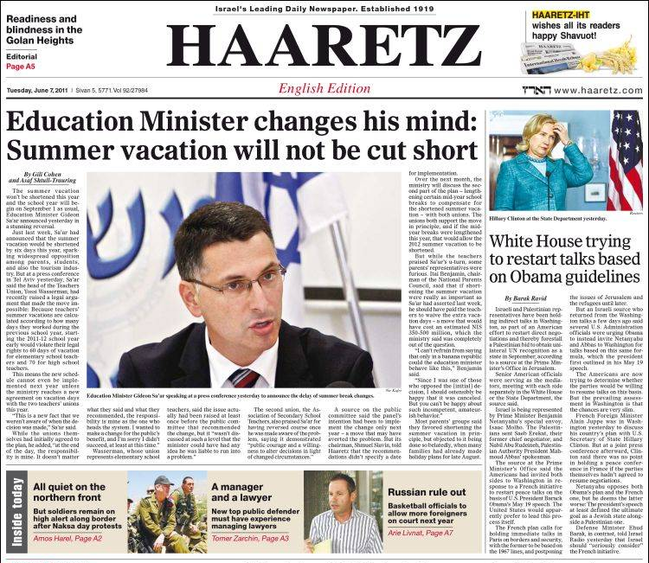
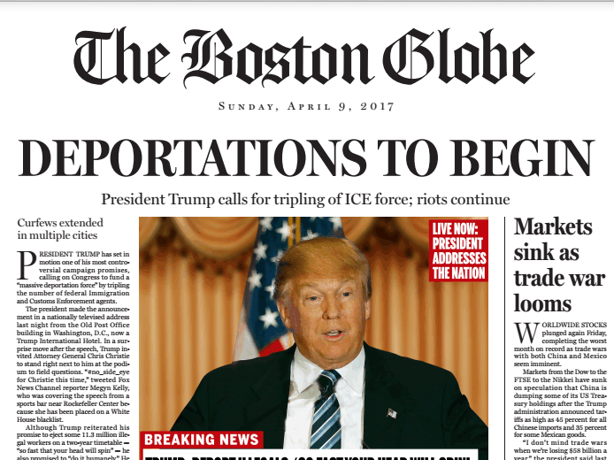
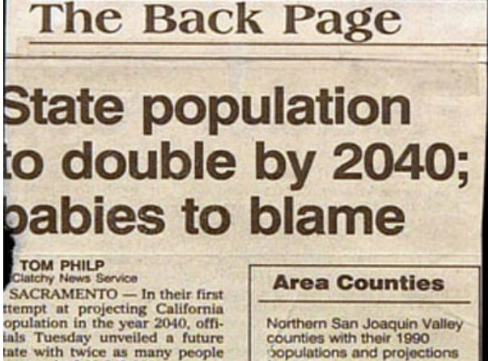
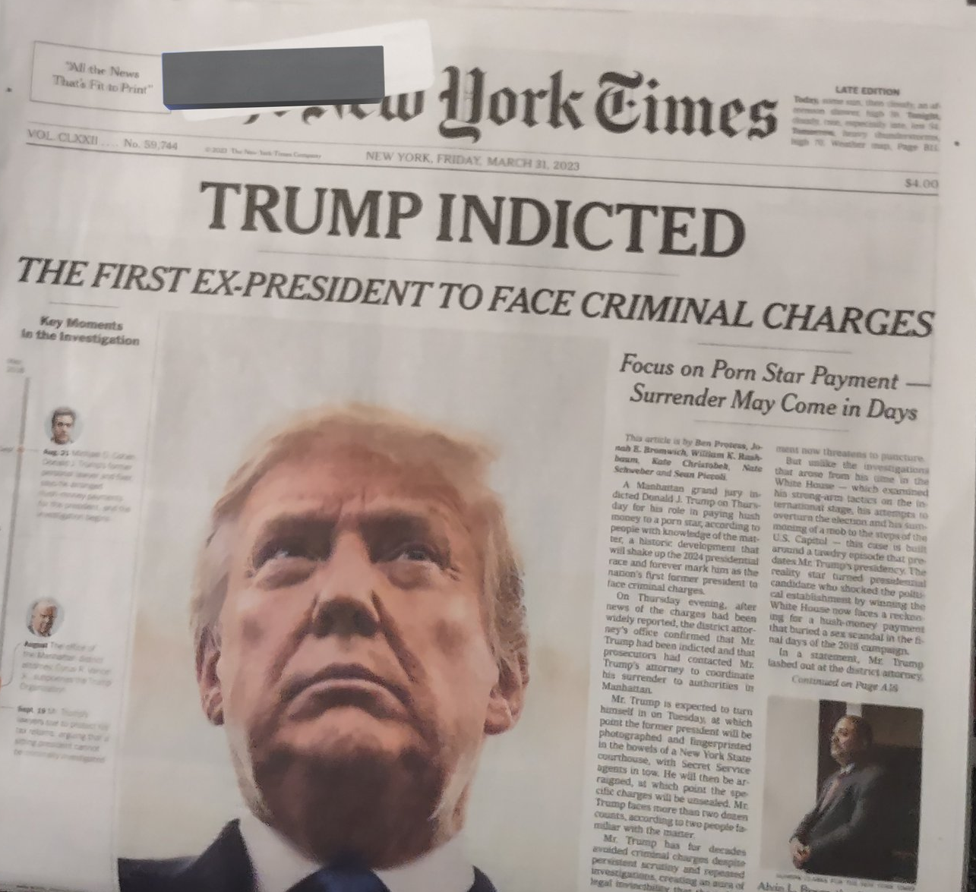
Political Announcements
Upcoming Product Launches
Predictions
Sports Events

Slide 3
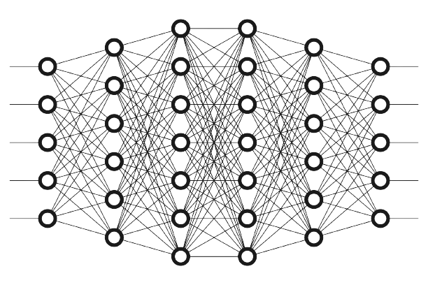

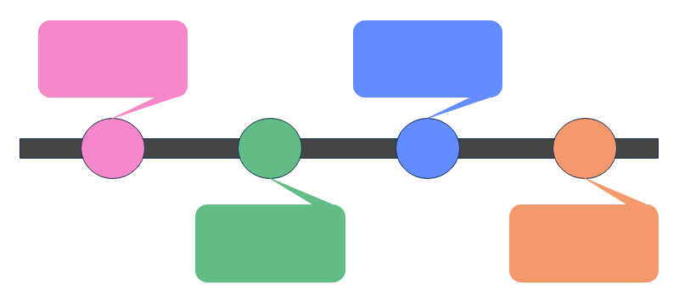
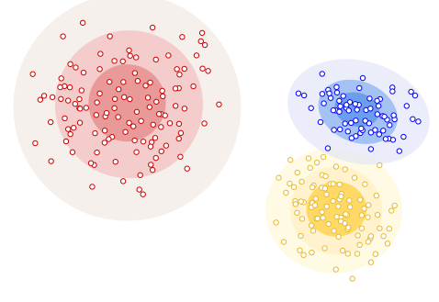
Query: Elon Musk
[1]
Take Positives
Download Articles
Extract Sentences
[2]
Classify Sentences
Topic 1: spacex – launch - rocket - starship
Topic 2: elon – visit - china - april
Topic 3: twitter – open source - code - release
[3]
[4]
Extract Topic Keywords
Create Timeline of Sentences containing Temporal Expressions
Cluster Future-Related Sentences

Slide 4
Data Retrieval
Goal: Provide Fast Access to Many Articles
Goal: Allow User to Specify #Articles and Time-Range

Slide 5

</NewsCatcher> News API
#articles
time-range
Query
Preprocessing

Slide 6
Query: Elon Musk
Topic 1: spacex – launch - rocket - starship
Topic 2: elon – visit - china - april
Topic 3: twitter – open source - code - release

Slide 7
Classification
Goal: Create Multi-Source Dataset
should contain sentences with
diverse structure
different words and
different topics

Slide 8
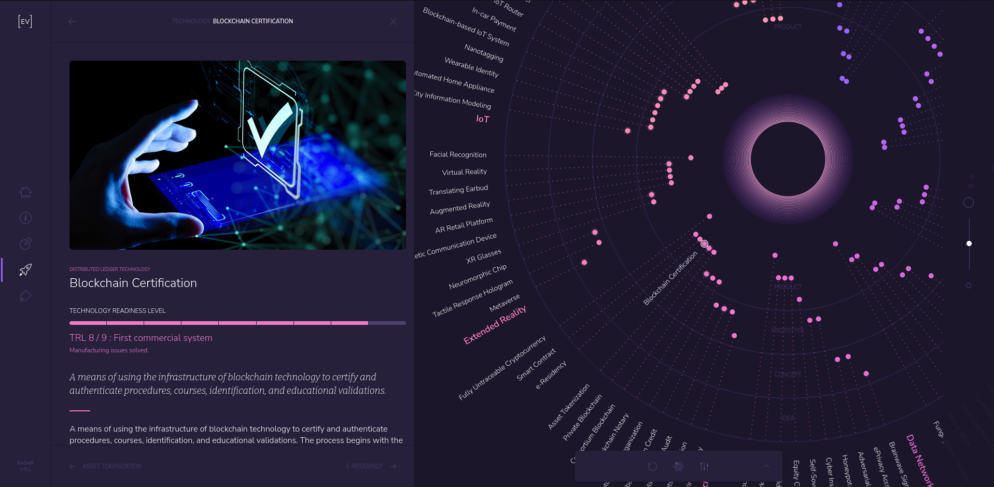


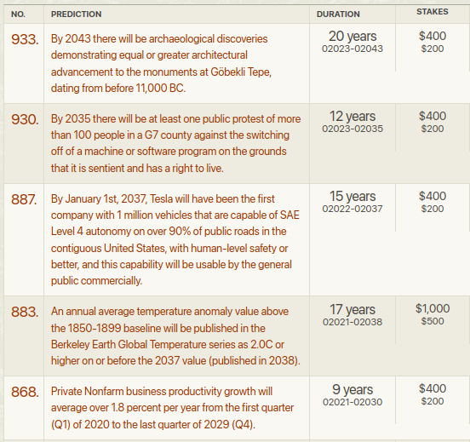
longbets.com
envisioning.io
ChatGPT
News
448
51
305
2501
positives
positives
positives
positives
0
62
305
3128
negatives
negatives
negatives
negatives

Slide 9
6800
total sentences
3305
3495
positives
negatives

Slide 10
Classification
Goal: Finetune Pre-trained Network on This Dataset
common approach: fine-tune pre-trained language model
pre-trained model:
- trained on large amount of data
- understands language
- trained with Masked Language Modeling (MLM)

Slide 11
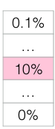

apple
...
FFNN + softmax
is
...
zebra
vector-embedding
...
Transformer-Encoder-Model
...
This [MASK] a short sentence
This is a short sentence

Slide 12
</NewsCatcher> News API
#articles
time-range
Preprocessing

Slide 13
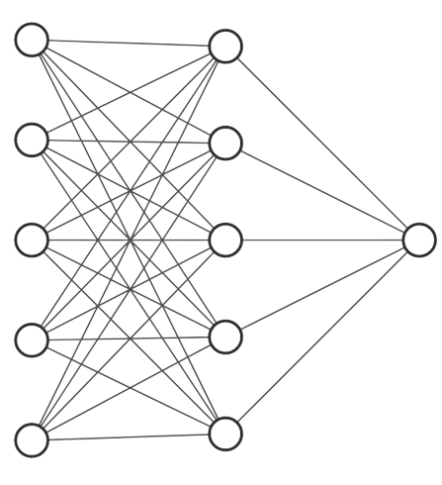
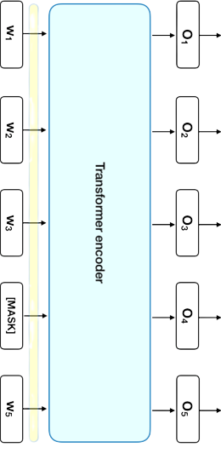
pre-trained
fine-tuned
DistilRoBERTa Transformer-Encoder
Mean-Pooling
[0;1]

Slide 14
Query: Elon Musk
Topic 1: spacex – launch - rocket - starship
Topic 2: elon – visit - china - april
Topic 3: twitter – open source - code - release

Slide 15
Topic Modeling
Goal: Cluster Future-Related Sentences into Topics

Slide 16
SPACEX-LAUNCH-STARSHIP-FIRST
In three days we could see the launch of the rocket that will someday take astronauts to Mars.
The Super Heavy booster will attempt a landing in Texas near its launch site.
The Starship Super Heavy rocket launch test could happen as soon as next week.
TWITTER-MUSK-OPEN SOURCE-CODE
Twitter owner Elon Musk, confirmed the move on Saturday, promising to publish more of the code in the next two weeks
Musk said that most of the recommendation algorithms will be made open source and the rest will follow.
AI-LETTER-OPENAI-DEVELOPMENT
Elon Musk has signed a letter from the Future of Life institute calling for a six-month hiatus in the development of AI.
In an open letter, the group said: 'Powerful AI systems should be developed only once we are confident that their effects will be positive'.

Slide 17
SPACEX-LAUNCH-STARSHIP-FIRST
In three days we could see the launch of the rocket that will someday take astronauts to Mars.
The Super Heavy booster will attempt a landing in Texas near its launch site.
The Starship Super Heavy rocket launch test could happen as soon as next week.
TWITTER-MUSK-OPEN SOURCE-CODE
Twitter owner Elon Musk, confirmed the move on Saturday, promising to publish more of the code in the next two weeks
Musk said that most of the recommendation algorithms will be made open source and the rest will follow.
BERTopic
Dimensionality Reduction (UMAP)
AI-LETTER-OPENAI-DEVELOPMENT
Clustering (HDBSCAN)
Elon Musk has signed a letter from the Future of Life institute calling for a six-month hiatus in the development of AI.
In an open letter, the group said: 'Powerful AI systems should be developed only once we are confident that their effects will be positive'.
Topic Keywords
(TF-IDF)

Slide 18
Query: Elon Musk
Topic 1: spacex – launch - rocket - starship
Topic 2: elon – visit - china - april
Topic 3: twitter – open source - code - release

Slide 19
Time-Tagging
Goal: Identify Temporal Expressions

Slide 20
SPACEX-LAUNCH-STARSHIP-FIRST
In three days we could see the launch of the rocket that will someday take astronauts to Mars.
The Super Heavy booster will attempt a landing in Texas near its launch site.
The Starship Super Heavy rocket launch test could happen as soon as next week.
TWITTER-MUSK-OPEN SOURCE-CODE
Twitter owner Elon Musk, confirmed the move on Saturday, promising to publish more of the code in the next two weeks.
Musk said that most of the recommendation algorithms will be made open source and the rest will follow.
AI-LETTER-OPENAI-SYSTEMS-DEVELOPMENT
Elon Musk has signed a letter from the Future of Life institute calling for a six-month hiatus in the development of AI.
In an open letter, the group said: 'Powerful AI systems should be developed only once we are confident that their effects will be positive'.

Slide 21
Time-Tagging
Goal: Map Temporal Expressions to Dates

Slide 22
Published 02.04.2023
In three days we could see the launch of the giant rocket that Elon Musk plans will someday take astronauts to Mars.
Published 03.04.2023
Twitter owner Elon Musk, confirmed the move on Saturday, promising to publish more of the code in the next two weeks.
Published 02.04.2023
Elon Musk has signed a letter from the Future of Life institute calling for a six-month hiatus in the development of AI.
[…] Elon Musk, confirmed […] publish code in the next two weeks.
In three days we could see the launch of the giant rocket […]
Elon Musk […] calling for a six-month hiatus [...]
05.04.2023
17.04.2023
02.10.2023
SUTime

Slide 23
chronicle2050.regevson.com

Slide 24
Sources
[1] https://img.myloview.com/stickers/newspapers-icon-outline-newspapers-vector-icon-for-web-design-isolated-on-white-background-400-239267931.jpg
[2] https://cdn-media-1.freecodecamp.org/images/11mpE6fsq5LNxH31xeTWi5w.jpeg
[3] https://developers.google.com/static/machine-learning/clustering/images/DistributionClustering.svg
[4] https://images.edrawmax.com/examples/blank-timeline-template/timeline7.png
[5] https://miro.medium.com/v2/resize:fit:876/0*ViwaI3Vvbnd-CJSQ.png

